Slide 1
Juneau Animal Rescue (JAR) formerly Gastineau Humane Society
1984 Shelter built & owned by JAR – 40 years ago – Facility rent free to CBJ
Per standards of that time, the shelter was built as “animal warehouse” with housing that is bad for animals and hard to service, inadequate air handling. Currently lacks space for animals and humans, poor foundation, and building deterioration.
1986 contract started with CBJ to independently enforce CBJ Animal Control Ordinance and animal welfare

Slide 2
Dog Housing – Too small, too noisy, hard and dangerous to clean kennels, hard to get dogs outside, lack of fresh air, too loud, reduces quality time for animals. .

Slide 3
Dog Exercise yard. Uncovered, hard to clean, unusable at times/kennel walls separating from floors increase cleaning problems

Slide 4
Cat Housing – kennels too small, stress inducing, stressful dog noise, lack of fresh air.

Slide 5
Non cat/dog pets (birds, lizards, ferrets, etc.) are caged in the hallway – Office space includes closets – not designed for animal control or veterinary medical services.

Slide 6
Lack of adequate air handling allows airborne disease to spread – A very serious problem

Slide 7
State of the art kennels – U of Wisconsin

Slide 8
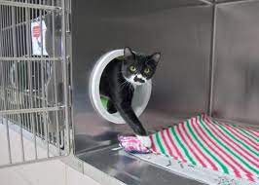
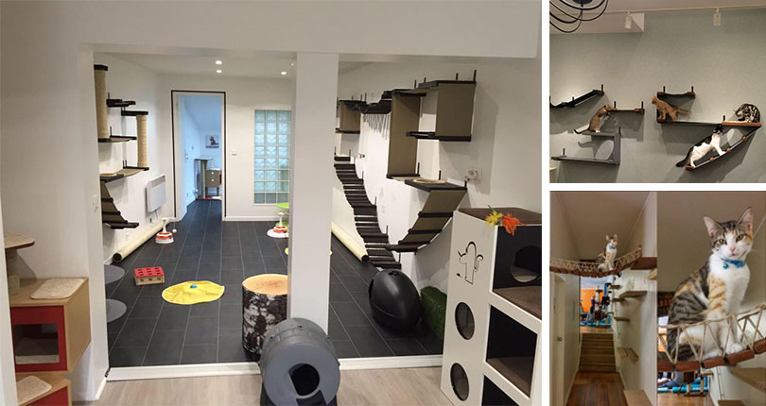
A new shelter good for people, GREAT for animals, must be a top priority for Juneau

Slide 9
Facility Assessment – 9/2021 - ASPCA Grant - University of California Davis Koret Shelter Medicine Program and an experienced animal shelter architecture firm Indigo Architects
Current Facility
8,090 Square Feet
Renovation of current structure too costly due to deterioration and inefficient design.
Current site too small and housing animals during construction problematic
New Facility
Up to 16,000 Square Feet
2023 construction estimate $17 -$20 million
2.2 acres – Not in residential area
JAR is initiating a capital campaign
CBJ must be a major partner as animal control and sheltering is a core municipal public safety function and public service.

Slide 10
Thank You!!!! We are happy to answer any questions

